Slide 1
Introduction to Business
Contemporary Business by Boone & Kurtz

Slide 2
What is Business?
Business consists of all profit-seeking activities and enterprises that provide goods and services necessary to an economic system.
Some businesses produce tangible goods while others provide services.

Slide 3
What is Business?
Definitions of Business
Business has three dimensions of a meaning
A commerce
An occupation
An organization

Slide 4
What is Business?
Definitions of Business
Business as a commerce is the process that people produce, exchange and trade goods and services

Slide 5
What is Business?
Definitions of Business
Business as an occupation is the acquired set of specialized skills and abilities that allows people to create valuable goods and services

Slide 6
What is Business?
Definitions of Business
Business as an organization is the system of task and authority relationship that coordinates and controls the interactions between people so that they work toward a common goal

Slide 7
What is Business?
Definitions of Business
Business as a system is a combination of business commerce, occupations, and organizations that produces and distributes the goods and services that create value for people in a society

Slide 8
Business Activities
A business must organize the people and equipment to provide the product.
People within the organization manage the company’s resources to produce the product.
The company markets the product or service by deciding where to sell it and how to advertise it.

Slide 9
Business’ Motivations
Profits represent rewards for businesspeople who take the risks involved in blending people, technology, and information to create and market want-satisfying goods and services.
Profit is the motivation for taking the risk to start a business. Profit is made by keeping sales high and costs low.

Slide 10
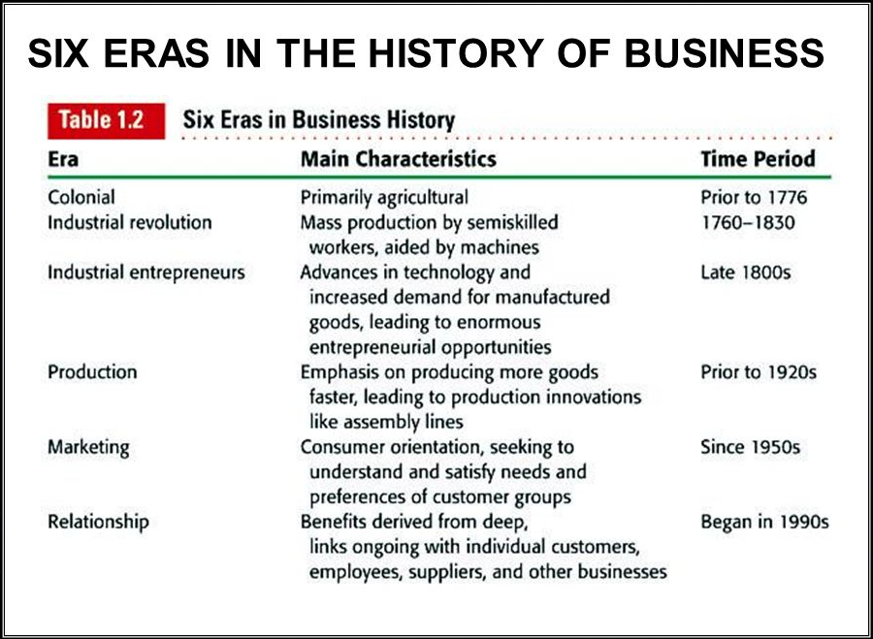

Slide 11
Components of business
Industry
Commerce
Industry is conversion of raw material into finished goods.
Primary industry
Secondary Industry

Slide 12
Primary Industry
Extracting industry
Extraction of underground resources.
Genetic industry
People doing business by changing genes.

Slide 13
Secondary Industry
Construction:
Construction of buildings, road, bridges etc.
Manufacturing:
Conversion of raw material into finished goods.
Services:
Banking, consultancy firms, accountant, lawyers, interior decorators, music composers etc.

Slide 14
Commerce
All those activities which start from the warehouse of the manufacturer to the buyer.
Types of Commerce:
Trade : buying and selling
Aid to Trade:
Institution that are meant and built to assist and support the trading process.

Slide 15
Factors of Production
Natural Resources- Agriculture land, building sites , forests, machinery etc.
Capital- Amount invested by investor in the organization
Human Resources- People working in an organization
Entrepreneurship- is the willingness to take risk to create and operate a business.

Slide 16
Economic System
Economy - Allocation of resources
Types:
Planned Economy-
A planned economy is a type of economic system where investment and the allocation of capital goods is performed through economy-wide economic and production plans.

Slide 17
Free Market Economy or Private Enterprise System
In economics, a free market is an idealized system in which the prices for goods and services are determined by the open market and consumers, in which the laws and forces of supply and demand are free from any intervention by a government, price-setting monopoly, or other authority.

Slide 18
Non-for Profit Organization
Organization have primary objectives other than returning profits to their owners
Need money to achieve their social goals
Private-sector not-for-profits include museums, libraries, trade associations, and charitable and religious organizations.
Public Sector not- for profit includes Government agencies, political parties, and labor unions

